Slide 1
Smart Home Catalog

Slide 2
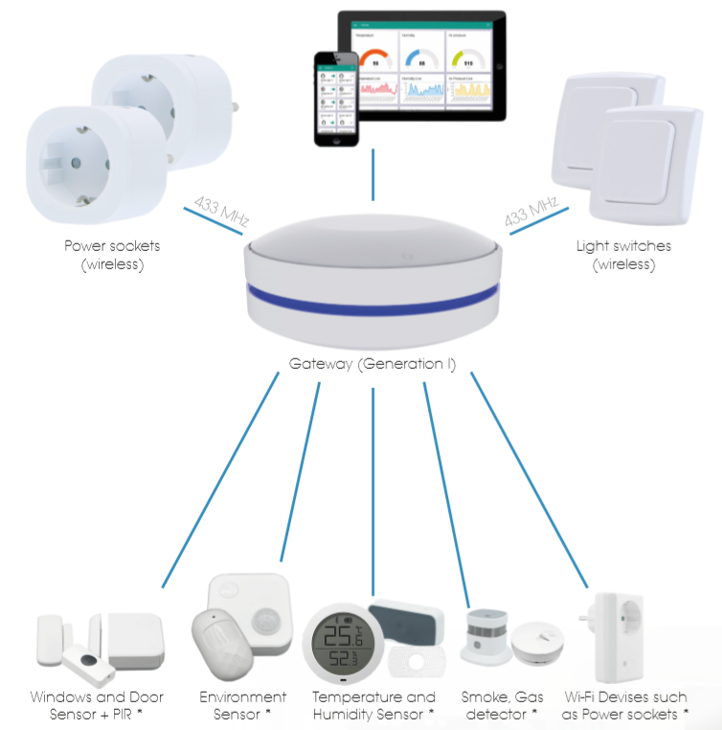
Smart Home Starter Kit
With the EASY TO USE Smart Home Starter Kit the user gets an extendable Kit which contains the Gateway with an integrated barometric sensor, two wireless controlled power sockets, two battery operated wall light switches which can be easily attached somewhere in the room (i.e. at the bed frame) and optional PIRs, door and window sensors and many other devices, which do use the supported radio frequencies or are controlled by Wi-Fi. As the Gateway is equipped with a learning function, just pair your devices.
Versatile settings can be done at the gateway. All can be easily controlled via a Web-interface on each device with a modern browser (PC, Tablet, Smart Phone). Accordingly, the user can independently switch the power sockets, on and off and/ or set various timers, observe the room air conditions like temperature, humidity and air pressure which will be shown in appealing graphical user interface.
In addition, the gateway is able to learn the IR signals from existing IR Remote controls such as for TVs, STBs, DVD Player, Hi-Fi system etc. With this function the user can setup rules / “scenes” in the gateway e.g. Scene 1 – turn on the power socket 1 (433 MHz / 868 MHz), together with the TV set, STB and the Hi-Fi System (via IR).
Compatible 433 MHz / 868 MHz / Wi-Fi / IR devices such as further power sockets, wall light switches, door and windows sensors, PIRs, outdoor environment sensors, smoke, gas and/or liquid detectors are already installed – then they could be paired with the Gateway and controlled easily via the Web-Interface by PC, Android or iOS devises.
This gateway is only active in your home network to ensure that no external access is granted via your IoT devices and that your devices continue to function in the event of a server failure.

